Slide 1
Operating System
Lecture #4
Introduction to OS

Slide 2
Objectives
How the OS evolute from past decades?
Types of OS.
System Calls

Slide 3
Evolution of OS
Operating Systems, has evolved in past years. It went through several changes before getting its original form. These changes in the operating system are known as the evolution of operating systems. The evolution of the operating system went through four generations.
First Generation: Type of operating system and devices used is Plug Boards.
Second Generation: Type of operating system and devices used is Batch systems
Third Generation: Type of operating system and devices used is Multiprogramming.
Fourth Generation: Type of operating system and devices used is personal computers

Slide 4
First Generation
This phase is considered from 1945-1955. It is the beginning of the development of electronic computing systems which are substitutes for mechanical computing systems. Because of the drawbacks in mechanical computing systems like, the speed of humans to calculate is limited and humans can easily make mistakes. In this generation there is no operating system, so the computer system is given instructions which must be done directly.

Slide 5
Second Generation
Second Generation (1955-1965)
The Batch processing system was introduced in the second generation, where a job or a task that can be done in a series, and then executed sequentially. In this generation, the computer system is not equipped with an operating system, but several operating system functions exist like FMS

Slide 6
Third Generation
Third Generation (1965-1980)
The development of the operating system was developed to serve multiple users at once in the third generation. Here the interactive users can communicate through an online terminal to a computer, so the operating system becomes multi-user and multiprogramming.

Slide 7
Fourth Generation
Fourth Generation (1980-Now)
In this generation the operating system is used for computer networks where users are aware of the existence of computers that are connected to one another.
At this generation users are also comforted with a Graphical User Interface (GUI), which is an extremely comfortable graphical computer interface, and the era of distributed computing has also begun.

Slide 8
Types of OS
Batch Operating System
Time-Sharing Operating Systems
Distributed Operating System
Network Operating System
Real-Time Operating System
Embedded Operating System
Clustered Operating system

Slide 9
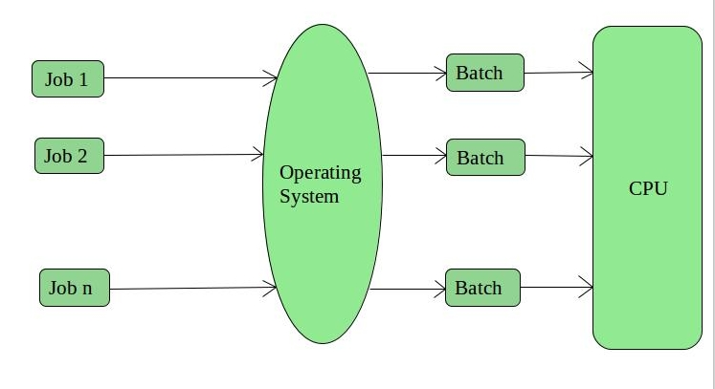
Batch Operating System
This type of operating system does not interact with the computer directly. There is an operator which takes similar jobs having the same requirement and group them into batches. It is the responsibility of the operator to sort jobs with similar needs.

Slide 10
Advantages and Disadvantages
Advantages of Batch Operating System:
It is very difficult to guess or know the time required for any job to complete. Processors of the batch systems know how long the job would be when it is in queue
Multiple users can share the batch systems
The idle time for the batch system is very less
It is easy to manage large work repeatedly in batch systems
Disadvantages of Batch Operating System:
The computer operators should be well known with batch systems
Batch systems are hard to debug
It is sometimes costly
The other jobs will have to wait for an unknown time if any job fails
Examples of Batch based Operating System: Payroll System, Bank Statements, etc.

Slide 11
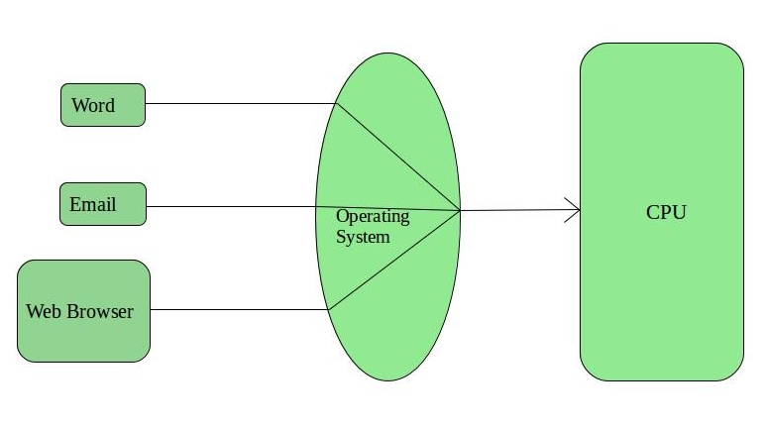
Time-Sharing Operating Systems
Each task is given some time to execute so that all the tasks work smoothly. Each user gets the time of CPU as they use a single system. These systems are also known as Multitasking Systems. The task can be from a single user or different users also. The time that each task gets to execute is called quantum. After this time interval is over OS switches over to the next task.

Slide 12
Advantages and Disadvantages
Advantages of Time-Sharing OS:
Each task gets an equal opportunity
Fewer chances of duplication of software
CPU idle time can be reduced
Disadvantages of Time-Sharing OS:
Reliability problem
One must have to take care of the security and integrity of user programs and data
Data communication problem
Examples of Time-Sharing OSs are: Multics, Unix, etc.

Slide 13
Distributed Operating System
These types of the operating system is a recent advancement in the world of computer technology and are being widely accepted all over the world and, that too, with a great pace. Various autonomous interconnected computers communicate with each other using a shared communication network.
Independent systems possess their own memory unit and CPU. These are referred to as loosely coupled systems or distributed systems. These system’s processors differ in size and function. The major benefit of working with these types of the operating system is that it is always possible that one user can access the files or software which are not actually present on his system but some other system connected within this network i.e., remote access is enabled within the devices connected in that network.

Slide 14
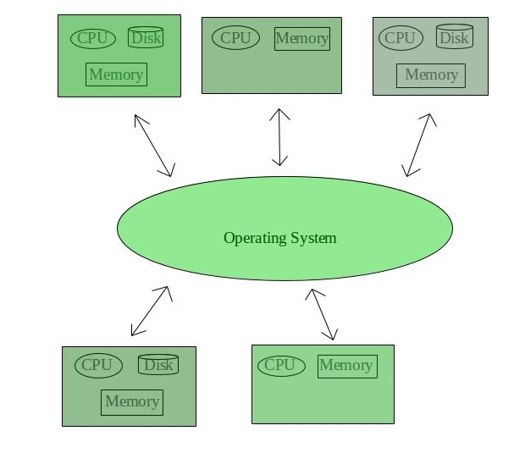

Slide 15
Advantages and Disadvantages
Advantages of Distributed Operating System:
Failure of one will not affect the other network communication, as all systems are independent from each other
Electronic mail increases the data exchange speed
Since resources are being shared, computation is highly fast and durable
Load on host computer reduces
These systems are easily scalable as many systems can be easily added to the network
Delay in data processing reduces
Disadvantages of Distributed Operating System:
Failure of the main network will stop the entire communication
To establish distributed systems the language which is used are not well defined yet
These types of systems are not readily available as they are very expensive. Not only that the underlying software is highly complex and not understood well yet
Examples of Distributed Operating System are- LOCUS, etc.

Slide 16
Network Operating System
These systems run on a server and provide the capability to manage data, users, groups, security, applications, and other networking functions. These types of operating systems allow shared access of files, printers, security, applications, and other networking functions over a small private network.
One more important aspect of Network Operating Systems is that all the users are well aware of the underlying configuration, of all other users within the network, their individual connections, etc. and that’s why these computers are popularly known as tightly coupled systems.

Slide 17
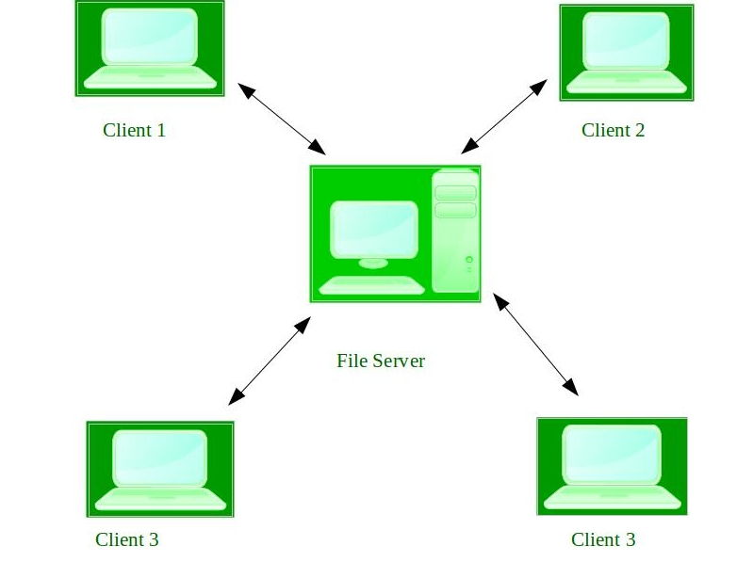

Slide 18
Advantages and Disadvantages
Advantages of Network Operating System:
Highly stable centralized servers
Security concerns are handled through servers
New technologies and hardware up-gradation are easily integrated into the system
Server access is possible remotely from different locations and types of systems
Disadvantages of Network Operating System:
Servers are costly
User has to depend on a central location for most operations
Maintenance and updates are required regularly
Examples of Network Operating System are: Microsoft Windows Server 2003, Microsoft Windows Server 2008, UNIX, Linux, Mac OS X, Novell NetWare, and BSD, etc.

Slide 19
Real-Time Operating System
These types of OSs serve real-time systems. The time interval required to process and respond to inputs is very small. This time interval is called response time.
Real-time systems are used when there are time requirements that are very strict like missile systems, air traffic control systems, robots, etc.
Two types of Real-Time Operating System which are as follows:
Hard Real-Time Systems: These OSs are meant for applications where time constraints are very strict and even the shortest possible delay is not acceptable. These systems are built for saving life like automatic parachutes or airbags which are required to be readily available in case of any accident. Virtual memory is rarely found in these systems.
Soft Real-Time Systems: These OSs are for applications where for time-constraint is less strict.

Slide 20
Embedded Operating System
An embedded operating system is a specialized operating system (OS) designed to perform a specific task for a device that is not a computer. The main job of an embedded OS is to run the code that allows the device to do its job. The embedded OS also makes the device's hardware accessible to software that is running on top of the OS.
An embedded OS often works within an embedded system. An embedded system is a computer that supports a machine. It performs one task in the bigger machine. Examples include computer systems in cars, traffic lights, digital televisions, ATMs,

Slide 21
Advantages and Disadvantages
Advantages of RTOS:
Maximum Consumption: Maximum utilization of devices and system, thus more output from all the resources
Task Shifting: The time assigned for shifting tasks in these systems are very less. For example, in older systems, it takes about 10 microseconds in shifting one task to another, and in the latest systems, it takes 3 microseconds.
Focus on Application: Focus on running applications and less importance to applications which are in the queue.
Real-time operating system in the embedded system: Since the size of programs are small, RTOS can also be used in embedded systems like in transport and others.
Error Free: These types of systems are error-free.
Memory Allocation: Memory allocation is best managed in these types of systems.
Disadvantages of RTOS:
Limited Tasks: Very few tasks run at the same time and their concentration is very less on few applications to avoid errors.
Use heavy system resources: Sometimes the system resources are not so good and they are expensive as well.
Complex Algorithms: The algorithms are very complex and difficult for the designer to write on.
Device driver and interrupt signals: It needs specific device drivers and interrupts signals to respond earliest to interrupts.
Thread Priority: It is not good to set thread priority as these systems are very less prone to switching tasks.
Examples of Real-Time Operating Systems are: Scientific experiments, medical imaging systems, industrial control systems, weapon systems, robots, air traffic control systems, etc.

Slide 22
Clustered Operating System
Cluster systems are similar to parallel systems because both systems use multiple CPUs. The primary difference is that clustered systems are made up of two or more independent systems linked together. They have independent computer systems and a shared storage media, and all systems work together to complete all tasks.

Slide 23
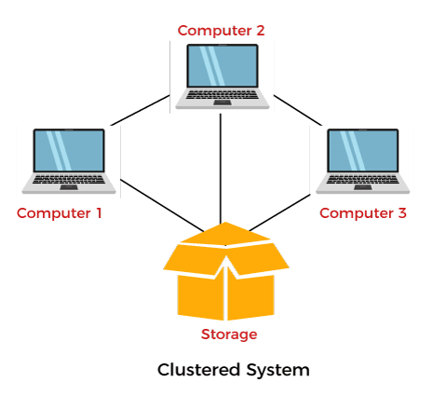
Clustered Operating System

Slide 24
System Calls
A system call is the programmatic way in which a computer program requests a service from the kernel of the operating system it is executed on.
A system call is a way for programs to interact with the operating system. A computer program makes a system call when it makes a request to the operating system’s kernel.
System call provides the services of the operating syste*m to the user programs via Application Program Interface(API). It provides an interface between a process and operating system to allow user-level processes to request services of the operating system. System calls are the only entry points into the kernel system. All programs needing resources must use system calls.

Slide 25
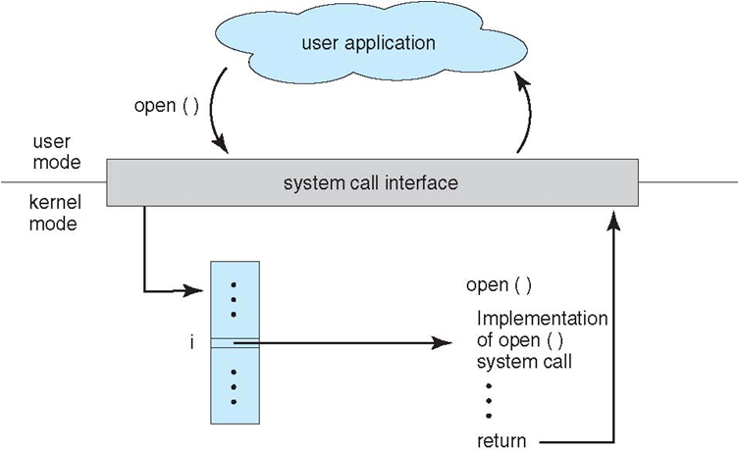

Slide 26
How System Calls Works?
The Applications run in an area of memory known as user space. A system call connects to the operating system's kernel, which executes in kernel space. When an application creates a system call, it must first obtain permission from the kernel. It achieves this using an interrupt request, which pauses the current process and transfers control to the kernel.
If the request is permitted, the kernel performs the requested action, like creating or deleting a file. As input, the application receives the kernel's output. The application resumes the procedure after the input is received. When the operation is finished, the kernel returns the results to the application and then moves data from kernel space to user space in memory.
A simple system call may take few nanoseconds to provide the result, like retrieving the system date and time. A more complicated system call, such as connecting to a network device, may take a few seconds. Most operating systems launch a distinct kernel thread for each system call to avoid bottlenecks. Modern operating systems are multi-threaded, which means they can handle various system calls at the same time.

Slide 27
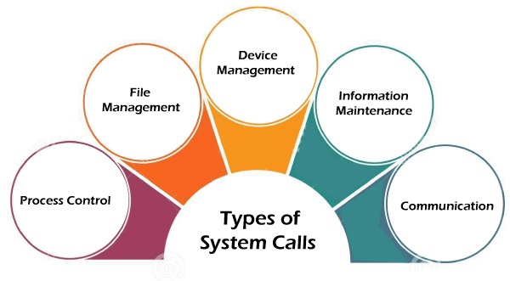
Notes:
here are 5 different categories of system calls –
Process control: end, abort, create, terminate, allocate and free memory.
File management: create, open, close, delete, read file etc.
Device management
Information maintenance
Communication

Slide 28
Types of System Calls
Process Control
Process control is the system call that is used to direct the processes. Some process control examples include creating, load, abort, end, execute, process, terminate the process, etc.
File Management
File management is a system call that is used to handle the files. Some file management examples include creating files, delete files, open, close, read, write, etc.
Device Management
Device management is a system call that is used to deal with devices. Some examples of device management include read, device, write, get device attributes, release device, etc.

Slide 29
Types of System Calls
Information maintenance is a system call that is used to maintain information. There are some examples of information maintenance, including getting system data, set time or date, get time or date, set system data, etc.
Communication
Communication is a system call that is used for communication. There are some examples of communication, including create, delete communication connections, send, receive messages, etc.

Slide 30
Process Control :
This system calls perform the task of process creation, process termination, etc.
The Linux System calls under this are fork() , exit() , exec().
fork()
A new process is created by the fork() system call.
A new process may be created with fork() without a new program being run-the new sub-process simply continues to execute exactly the same program that the first (parent) process was running.
It is one of the most widely used system calls under process management.
exit()
The exit() system call is used by a program to terminate its execution.
The operating system reclaims resources that were used by the process after the exit() system call.
exec()
A new program will start executing after a call to exec()

Slide 31
File Management :
File management system calls handle file manipulation jobs like creating a file, reading, and writing, etc. The Linux System calls under this are open(), read(), write(), close().
open():
It is the system call to open a file.
This system call just opens the file, to perform operations such as read and write, we need to execute different system call to perform the operations.
read():
This system call opens the file in reading mode
We can not edit the files with this system call.
Multiple processes can execute the read() system call on the same file simultaneously.
write():
This system call opens the file in writing mode
We can edit the files with this system call.
Multiple processes can not execute the write() system call on the same file simultaneously.
close():
This system call closes the opened file.

Slide 32
Device Management :
Device management does the job of device manipulation like reading from device buffers, writing into device buffers, etc. The Linux System calls under this is ioctl().
ioctl():
ioctl() is referred to as Input and Output Control.
ioctl is a system call for device-specific input/output operations and other operations which cannot be expressed by regular system calls.

Slide 33
Information Maintenance:
It handles information and its transfer between the OS and the user program. In addition, OS keeps the information about all its processes and system calls are used to access this information. The System calls under this are getpid(), alarm(), sleep().
getpid():
getpid stands for Get the Process ID.
The getpid() function shall return the process ID of the calling process.
The getpid() function shall always be successful and no return value is reserved to indicate an error.
alarm():
This system call sets an alarm clock for the delivery of a signal that when it has to be reached.
It arranges for a signal to be delivered to the calling process.
sleep():
This System call suspends the execution of the currently running process for some interval of time
Meanwhile, during this interval, another process is given chance to execute

Slide 34
Information Maintenance:
It handles information and its transfer between the OS and the user program. In addition, OS keeps the information about all its processes and system calls are used to access this information. The System calls under this are getpid(), alarm(), sleep().
getpid():
getpid stands for Get the Process ID.
The getpid() function shall return the process ID of the calling process.
The getpid() function shall always be successful and no return value is reserved to indicate an error.
alarm():
This system call sets an alarm clock for the delivery of a signal that when it has to be reached.
It arranges for a signal to be delivered to the calling process.
sleep():
This System call suspends the execution of the currently running process for some interval of time
Meanwhile, during this interval, another process is given chance to execute

Slide 35
Communication :
These types of system calls are specially used for inter-process communications.
Two models are used for inter-process communication
Message Passing(processes exchange messages with one another)
Shared memory(processes share memory region to communicate)
The system calls under this are pipe() , shmget() ,mmap().
pipe():
The pipe() system call is used to communicate between different Linux processes.
It is mainly used for inter-process communication.
The pipe() system function is used to open file descriptors.
shmget():
shmget stands for shared memory segment.
It is mainly used for Shared memory communication.
This system call is used to access the shared memory and access the messages in order to communicate with the process.
mmap():
This function call is used to map or unmap files or devices into memory.
The mmap() system call is responsible for mapping the content of the file to the virtual memory space of the process.

Slide 36
Any Query??

